Slide 1
Historical Development of Cars
Car is a wheeled vehicle that carries its own motor and transports passengers
Introduction
History of Cars starting with the first steam, electrical, and gasoline-engine cars
Famous Automobile Makers
Karl Benz, the German mechanical engineer who designed world's first practical automobile in 1885
Henry Ford, improved the assembly line for automobile manufacturing and invented a car transmission mechanism.
He invented the assembly line process which brought the cost of the auto down to an affordable level. He put the automobile into the hands of the masses

Slide 2
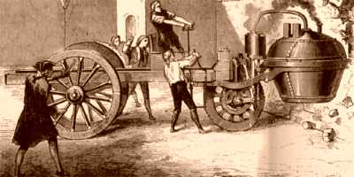
Early Steam Powered Cars

Slide 3
Early Steam Powered Cars
The first theoretical plans for a motor vehicle that had been drawn up by both Leonardo da Vinci and Isaac Newton.
In 1769, the very first self-propelled road vehicle was a military tractor invented by French engineer and mechanic, Nicolas Joseph Cugnot Cugnot used a steam engine to power his vehicle. It was used by the French Army to haul artillery at a whopping speed of 2 1/2 mph on only three wheels.
How Steam Engines Works.?
Steam engines powered cars by burning fuel that heated water in a boiler, creating steam that expanded and pushed pistons that turned the crankshaft, which then turned the wheels. During the early history of self-propelled vehicles - both road and railroad vehicles were being developed with steam engines

Slide 4
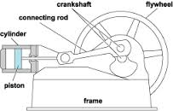
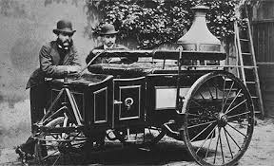
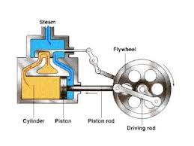
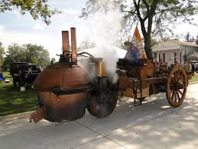
How Steam Engines Works.?

Slide 5
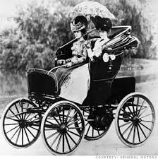
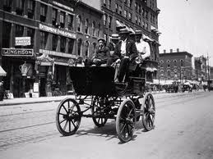
Electric Cars
Early Electric Cars
Steam engines were not the only engines used in early cars. Vehicles(Cars) with electrical engines were also invented. Between 1832 and 1839 , Robert Anderson of Scotland invented the first electric carriage. Electric cars used rechargeable batteries that powered a small electric motor. The vehicles were heavy, slow, expensive, and needed to stop for recharging frequently..

Slide 6
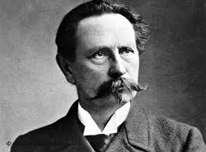
Internal Combustion Engine
Definition
An internal combustion engine is any engine that uses the combustion of fuel to push a piston within a cylinder. The different types of fuel commonly used for car combustion engines are gasoline (or petrol), diesel, and kerosene
KarlBenz
In 1885, German mechanical engineer, Karl Benz designed and built the world's first practical automobile to be powered by an internal-combustion engine. On January 29, 1886, Benz received the first patent (DRP No. 37435) for a gas-fueled car. It was a three-wheeler; Benz built his first four-wheeled car in 1891. Benz & Cie., the company started by the inventor, became the world's largest manufacturer of automobiles by 1900. Benz was the first inventor to integrate an internal combustion engine with a chassis - designing both together.

Slide 7
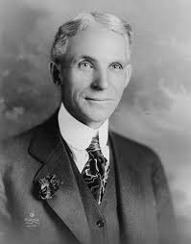
Henry Ford
HenryFord
American car manufacturer, Henry Ford (1863-1947) invented an improved assembly line and installed the first conveyor belt-based assembly line in his car factory in Ford's Highland Park, Michigan plant, around 1913-14. The assembly line reduced production costs for cars by reducing assembly time. Ford's famous Model T was assembled in ninety-three minutes. Ford made his first car, called the "Quadricycle," in June, 1896. Ford became the world's biggest car manufacturer. By 1927, 15 million Model Ts had been manufactured.

Slide 8
Leading Car Manufacturers
Toyota
Multinational automaker Toyota is the world's largest automobile manufacturer.
General Motors General Motors is an American multinational automotive corporation headquartered in Detroit, Michigan
Volkswagen Volkswagen is a German automobile manufacturer, Volkswagen means 'people's car' in German. It was founded on 28 May 1937 by Ferdinand Porsche.
Hyundai Motors Hyundai Kia Automotive Group is the world's fastest growing automaker. Headquartered in Seoul, South Korea
Ford Motor Company An American multinational automaker based in Dearborn, Michigan, it was founded by Henry Ford and incorporated on June 16, 1903.
Nissan Multinational automaker Nissan is headquartered in Japan
Honda Honda, a Japanese multinational corporation manufactures automobiles and motorcycles. Soichiro Honda and Takeo Fujisawa founded the company on 24 September 1948
PSA Peugeot Citroen PSA Peugeot Citroen is a French manufacturer of automobiles and motorcycles sold under the Peugeot and Citroen marques.
Suzuki Japanese multinational corporation Suzuki specialises in manufacturing compact automobiles, motorcycles, all-terrain vehicles (ATVs)
Renault French automaker, Renault manufactures cars and vans. Renault and Nissan are leading electric car development among major car companies

Slide 9
Leading Car Manufacturers
11. Fiat FIAT stands for Fabbrica Italiana Automobili Torino. An Italian automobile manufacturer based in Turin, Fiat was founded in 1899 by a group of investors including Giovanni Agnelli
12. Daimler AG Daimler AG, a German car corporation is the 12th largest car manufacturer and second-largest truck manufacturer in the world.
13. Chrysler American-based multinational automaker headquartered in the Detroit suburb of Auburn Hills was first organised as the Chrysler Corporation in 1925
14. BMW Bavarian Motor Works (BMW) is a German automobile, motorcycle and engine manufacturing company founded in 1916. It also owns and produces the Mini marque.
BMW produces motorcycles under BMW Motorrad and Husqvarna brands. The company was founded in 1916 by Franz Josef Popp.
15. Mazda Mazda Motor Corporation is based in Fuchu, Aki District in Japan.

Slide 10









Basic Car Model Design
SUV
Sedan
Luxury Car
Pickup Truck
Crossover
Hatch Back
Mini Van
Convertible
Coupe
Hybrid Car

